Slide 1
2021-1-BE03-KA210-ADU-000034041

Slide 2
Contents
DINNER CLUB
Idea behind DINNER CLUB
History of DINNER CLUB
Content of DINNER CLUB
Target groups for DINNER CLUB
How to use DINNER CLUB
What´s needed for the use of DINNER CLUB
Expectations from the use of DINNER CLUB
Further plannings for DINNER CLUB

Slide 3
Dinnerclub - Idea
Cook together
Eat together
Perform together
Dance together
collect donations together
for the benefit of people (refugees, asylum seekers, disabled people) who need financial support

Slide 4
Dinnerclub - History
For more than 20 years (in Innsbruck/Austria)
With the support of “Caritas Innsbruck”
Every Friday evening
One cook team is preparing a meal for (max) 100 guests
Location: Event location of Caritas Innsbruck

Slide 5
Dinnerclub - Content
Dinnerclub is a regional charity dinner (organized by Volunteers) with the goal to collect money and to bring social excluded person together with “NOT” exclude person from society
Dinnerclub is also a platform for Artists, Musicians etc to entertain

Slide 6
What is needed to organize a Dinnerclub
Volunteers to organize a dinner club
for service and food preparation
Kitchen with equipment for about 100 guests
Tables and chairs for about 100 guests
Depending on the country you can organize a Dinnerclub “indoor” or “outdoor”

Slide 7
Dinnerclub - Expectations
Integration of social excluded people into our regional communities
Collection of money for social excluded people
Intercultural exchange of recipes
Intercultural exchange of music, dances…arts

Slide 8
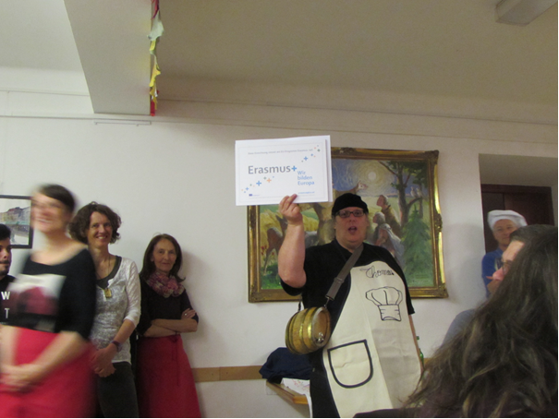
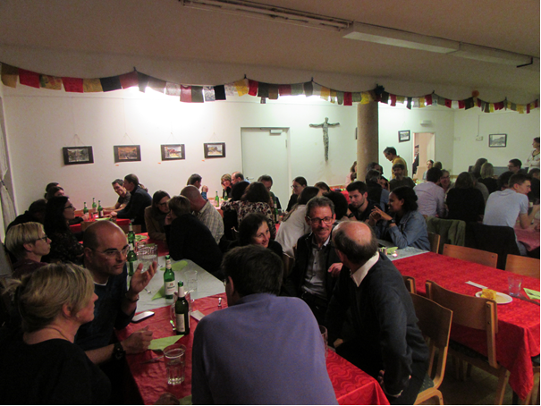
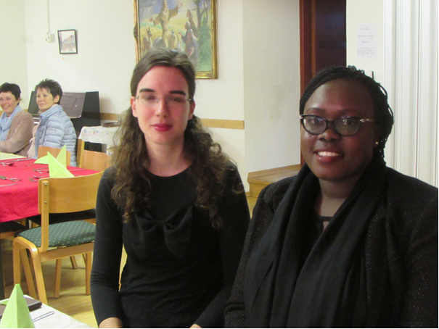
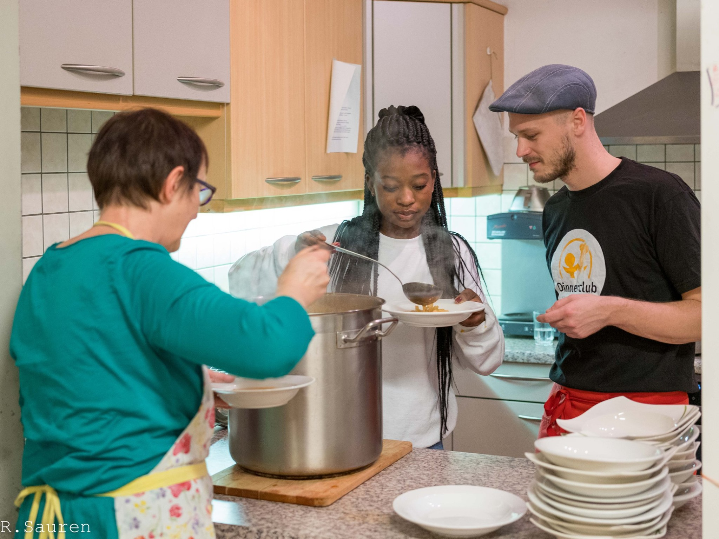
Dinner Club - Impressions

Slide 9
Dinnerclub - www
http://www.dinnerclub-innsbruck.at/home/
https://www.facebook.com/Caritas.INTEGRATIONSHAUS.INNSBRUCK/

Slide 10
Mag. Thomas Vondrak
VondiConsulting
office@vondi.eu
00436642817496

