Slide 1
2021-1-BE03-KA210-ADU-00034041

Slide 2
SMILE and
Virtual
Mobility
Digital and Soft Skills for the 21st century

Slide 3
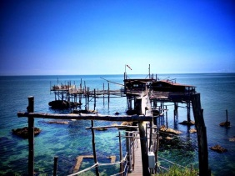
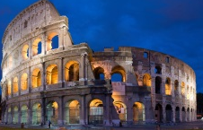
About TuFirst Onlus
NGO located in Abruzzo,
Central Italy
Today's
Agenda
Active in the promotion of innovation and digital
Development of professional and soft skills
Rome
Face-to-face and online courses

Slide 4
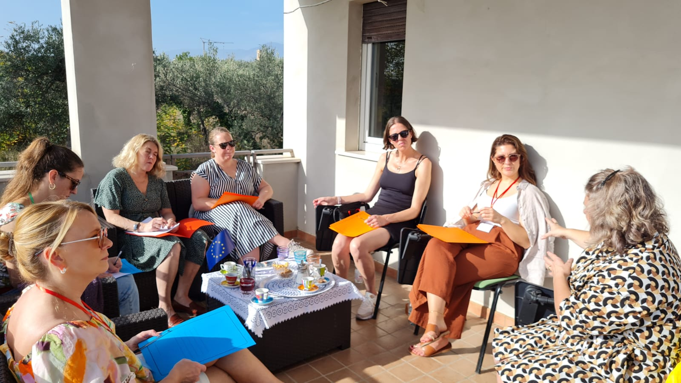
Individual Development Plan SMILE
S
M
I
L
E
tructure
otivation
nnovation/Immagination/Inspire/Hard Work
ong term dreams and goals
nthusiasm

Slide 5
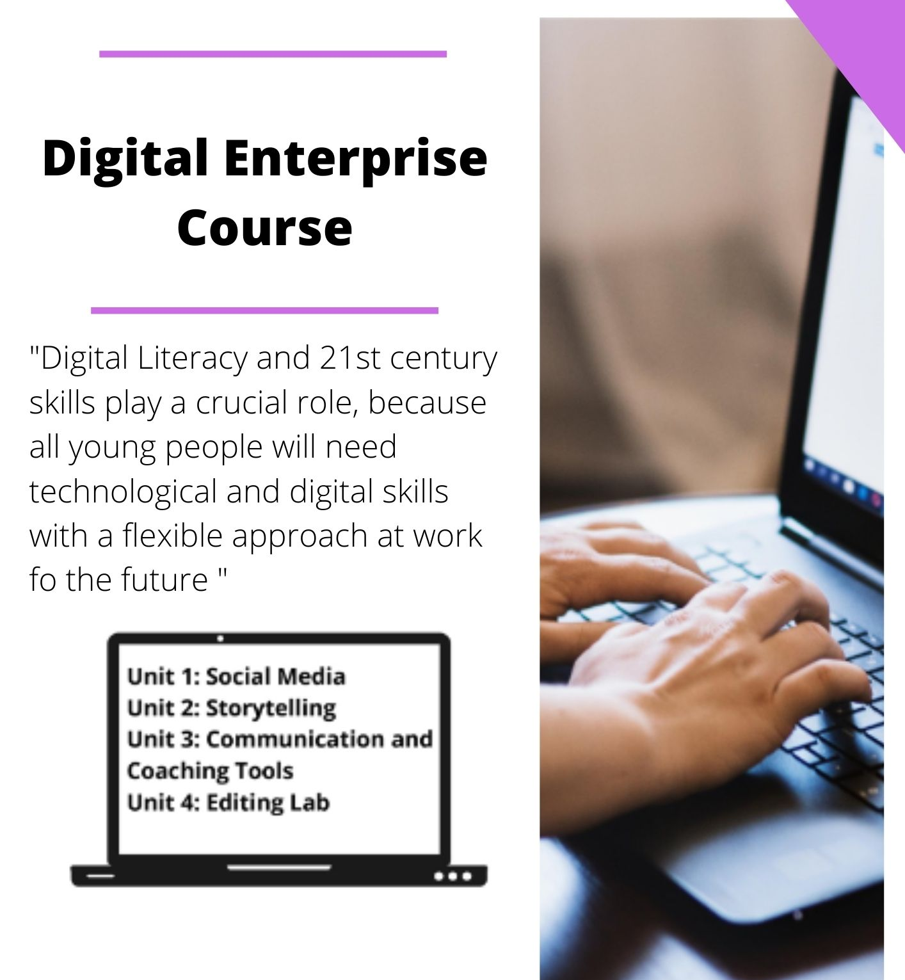
Virtual Mobility Courses
Digital Enterprise https://moodle.dywproject.org/
Into the Digital World
https://elearning.dymproject.eu/course/view.php?id=2

Slide 6
What you will learn with our courses
How to create, manage and improve your image online
How to create professional Video Curriculum and Presentation on-line
How to improve your skills for an effective communication online and in real life to be employable

Slide 7
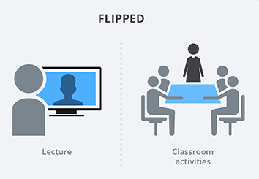
What does it include?
Professional tutors to consolidate learning
Mentor for constant follow up and motivation
4 Units with work-based activities
Whatsapp group for constant motivation
Flipped Teaching technique
Cultural Activities for intercultural exchange
at distance

Slide 8
Consolidate the learning -
Example of Lesson
Recording techniques
Push the “rec” button without a reason
Start recording without having prepared a detailed storytelling
Move the smartphone fast
AND…

Slide 9
Consolidate the learning -
Example of Lesson
Recording techniques
Record the scene for which you have already prepared the storytelling for
Follow the rule of the thirds for a correct framing
Follow the timeline
Record different takes for the video which will be then edited together
AND…

Slide 10
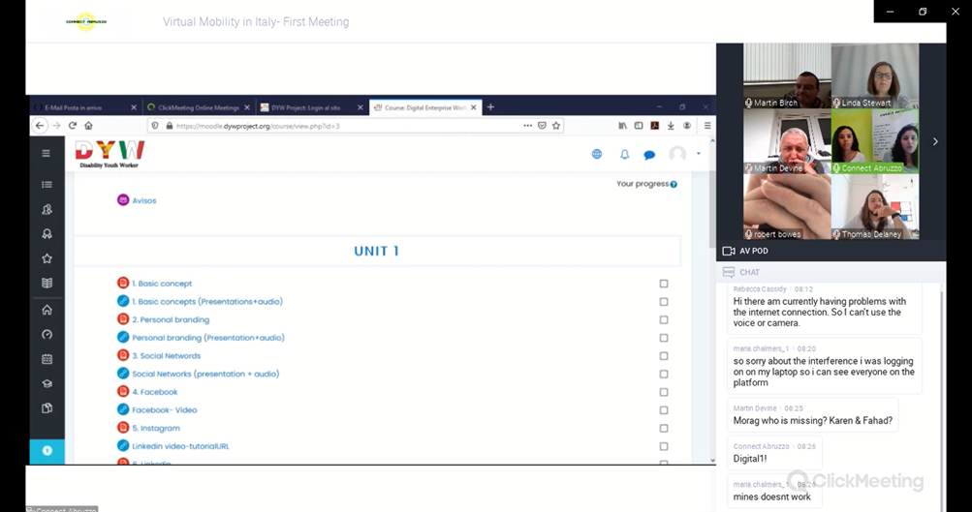
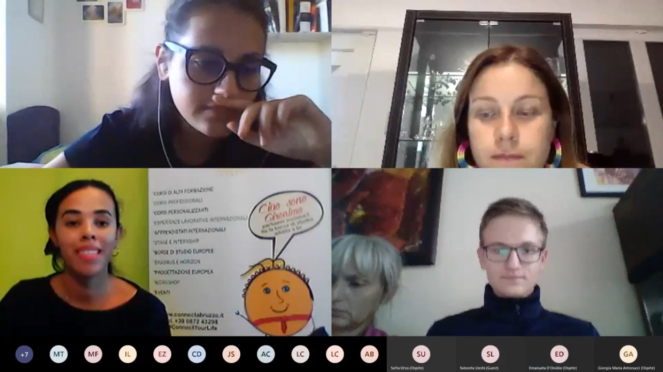
Our Virtual Mobility Courses
Example of Lesson

Slide 11
Follow Us
Example of Lesson
Fb: https://www.facebook.com/ConnectAbruzzo
Web-Page: www.connectabruzzo.it

